Slide 1
Top Ten Myths of Third-party Inspection
Roy O. Christensen, RET
KT Project
NACE Calgary Webinar
May 27, 2022
Notes:
Thank you for attending this presentation. Today I will discuss the top 10 myths + 2 supplemental myths about third-party inspection and offer some facts to refute these myths.

Slide 2
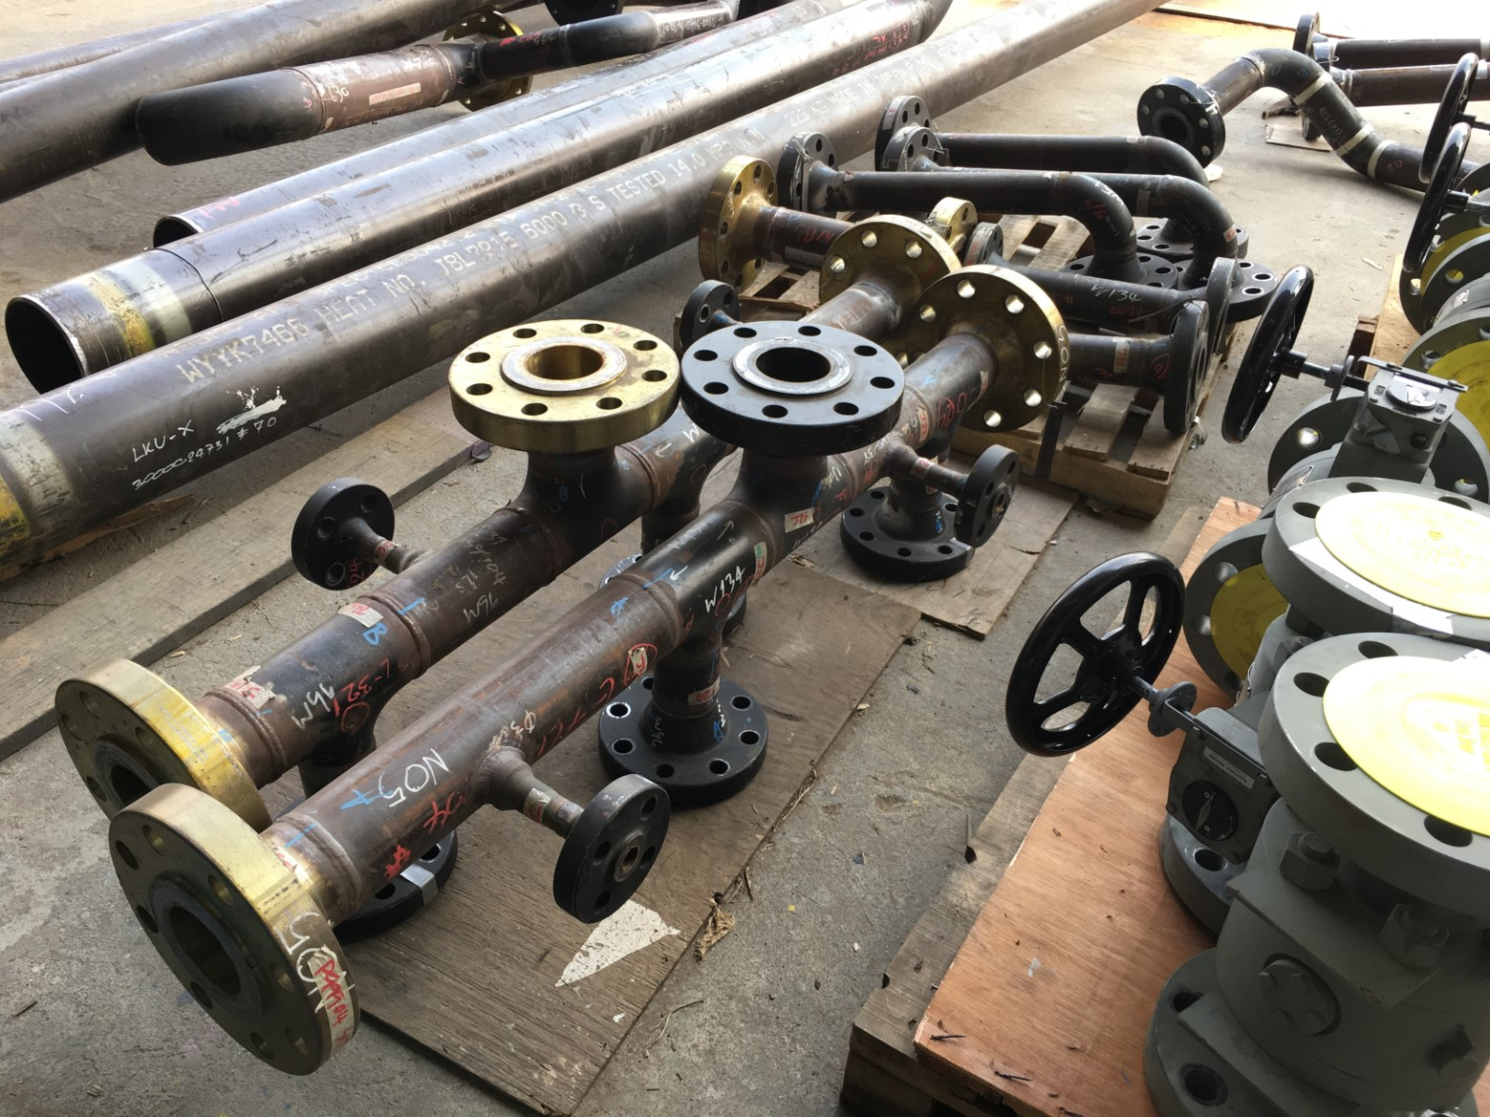
Communication
The Project Management Institute’s (PMI’s) report The Essential Role of Communication stated: ineffective communication has a negative impact on project success >50% of the time
Communication and
understanding are key
to project success
Notes:
I started working as a third-party inspector before email was invented. Sometimes, a product was almost complete before the initial visit! Then, the product was shipped before final inspection! Why is it so hard?

Slide 3
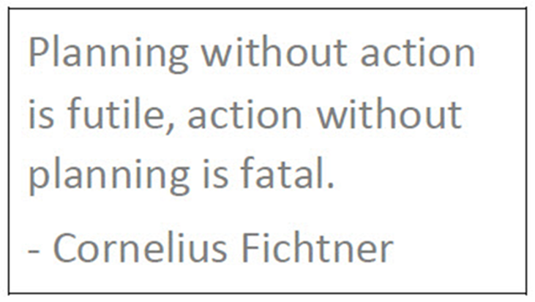
Introduction
Capital projects in energy and other sectors use third-party inspection (inspection) to ensure suppliers’ equipment and materials are delivered:
Complete
Correct
On-time
Inspection is also known as:
Source surveillance
Vendor surveillance
Visual inspection
Notes:
Inspection is a quality surveillance activity performed by comparing inspection results with specified requirements to verify if conformity is achieved for a product or service.

Slide 4
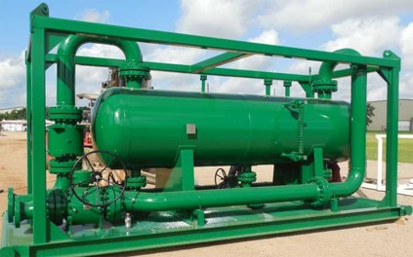
Introduction
Inspection is a misunderstood function because of hidden knowledge gaps. There are many pervasive myths about its:
Methods
Objectives
Strategies
Knowledge transfer is needed! This
presentation dispels 10 inspection myths
and two supplemental myths with facts.
Notes:
Inspection is integral to many energy projects and typically part of the procurement or supply chain management group, but inspection is not a well-understood function.

Slide 5
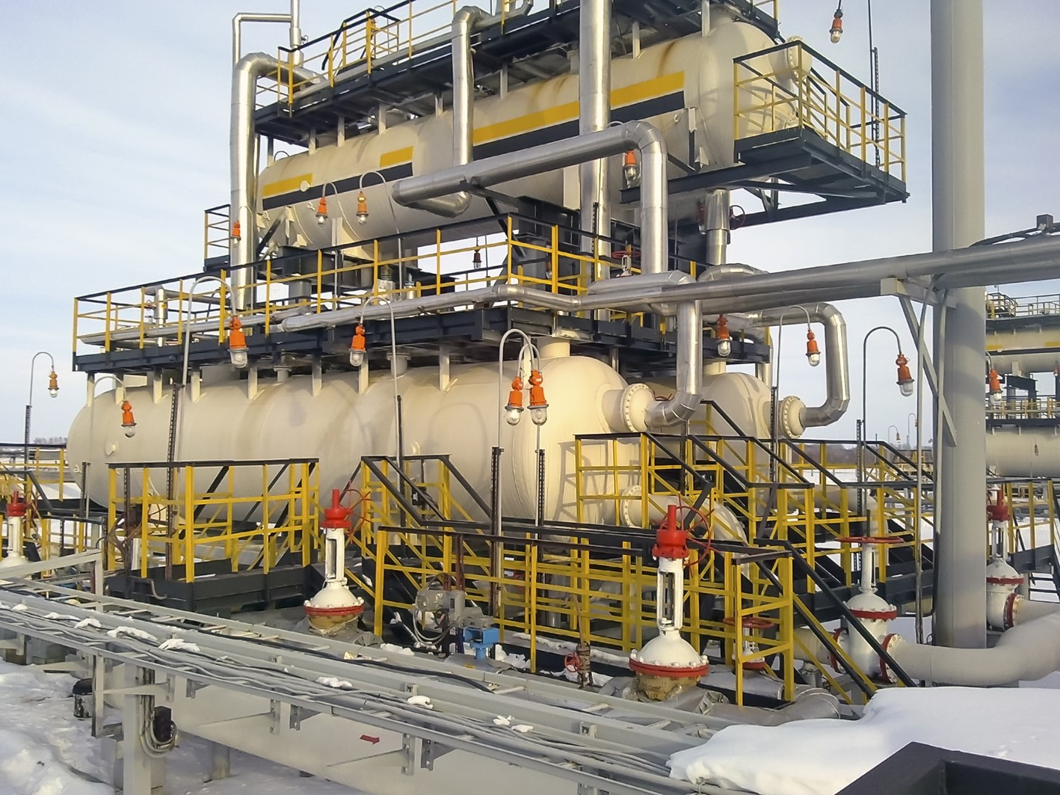
Introduction
This presentation applies to inspection at construction sites and supplier facilities for these disciplines:
Coating
Electrical
Instrumentation
Mechanical
Welding
Notes:
Inspection requirements are established by the project and not the code of construction. One exception is for inspection of piping systems and signing the piping system data reports (e.g., AB-83 form).

Slide 6
Myth #1
Inspection is a quality assurance/quality control (QA/QC) function
False
Inspection provides a risk management function, not a quality management function (e.g., it is not an ISO 9001, Quality Management Systems — Requirements program)
Project risk tolerances vary, and the appropriate amount of inspection depends on the project cost, type, and other factors (e.g., complexity, criticality, location, size, and pipeline or plant)
Notes:
Inspection is like insurance. It is possible to have too little or too much. The client, project team, or a combination decide how much inspection is needed or not needed, usually using a cost-benefit analysis.

Slide 7
Myth #2
Inspection removes liability
Wrong
Inspection does not ensure deliverables are perfect or duplicate supplier QC
Inspection selectively determines compliance during production
Inspectors assume no responsibility for the quality of the procurement documents or the supplier’s deliverables
Notes:
Inspection cannot ensure that supplier facilities, procedures, and products are error‐free or perfect because this is neither possible nor reasonable. No facility is error‐free or perfect. Especially not the nightshift.

Slide 8
Myth #3
Inspection can be set-up ad hoc or as needed
It can be, but …
Properly planned inspection is more effective
and value added because it permits a project
to identify and correct challenges before
significant consequences can occur
(e.g., early or on paper instead of during
production or construction)
A repair at site can cost 10x more than at the
supplier’s facility and impacts to construction
contractors and schedules can be costly!
Notes:
Capital projects takes months and years to complete, so inspection should be planned from the beginning. An inspector can ask questions, which yield very expensive, inconvenient, or undesirable responses.

Slide 9
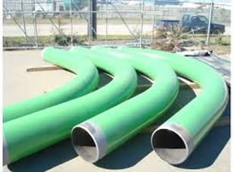
Myth #4
Inspection resources are available whenever and wherever required
Unlikely
Inspection resources may or may not be available when and where needed
A smart project plans inspection activities and
contingencies during detailed engineering – not
when services are needed
It is unprofessional to ask an inspector to drop
their assignments and commitments so they
can solve another project’s problem
Notes:
For example: coating inspection requirements may be established – somewhere and at some time. Suddenly, the project is notified that an inspector is needed in Madison, WI next Monday morning!

Slide 10
Myth #5
Inspectors are immediately available for a project
Unlikely
Like other busy professionals, inspectors keep carefully-planned and demanding schedules
Inspectors may be inflexible or
unavailable on short notice
In many major centers an inspector can
only visit one or two suppliers per day, or
they may not have a personal vehicle and
need to use public transit
Notes:
A project is a microcosm of daily activities, emails, and meetings and then – suddenly, the project needs an inspector for a few hours or days. Typically, until the inspector is needed, they are not involved.

Slide 11
Myth #6
Inspection expertise is always readily available
Probably not
Due to the downturn, industry is losing many talented professionals who cannot be replaced and attrition is increasing as the baby boomers retire
A smart project uses strategies and teamwork to manage inspection activities cost effectively, especially if:
Available resources are less experienced, or no resources are available locally (e.g., significant travel expenses would be required)
Assigning a resource for more than one discipline (e.g., coating, electrical, mechanical, welding, or a combination).
Notes:
Projects can usually secure suitably-qualified local inspectors in major centres such as Edmonton, AB or Houston, TX. This may not be the case, in locations such as Lloydminster, AB or Painted Post, NY.

Slide 12
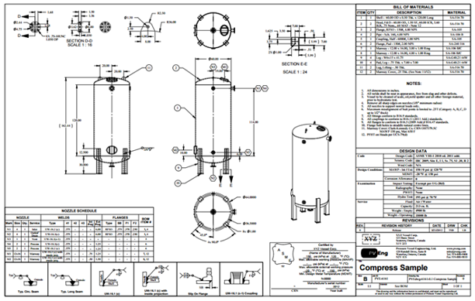
Myth #7
Inspectors have immediate access to all procurement and supplier documents
Not true
Inspectors have access to select digital and hard copy documentation for inspection that is issued by the SQS
coordinator, supplier, or a combination
Remember: inspection is a risk
management function – not a
quality management function (see Myth 1)
Notes:
Projects used to courier printed materials to the inspector – no longer! The inspector is not a document controller. They cannot be added to document control distribution and expected to figure it out.

Slide 13
Myth #8
An inspector’s acceptance of documentation or inspection results is final
False
The responsible engineer or site receiver is
responsible for final acceptance of documentation
and product, regardless of previous acceptance
by others
There may be additional or other requirements to
consider, or a cold-eyes review may identify a
deficiency
Notes:
Inspectors are knowledgeable about acceptance criteria and usually competent to accept results. They will inspect a product or review documentation, and report on acceptability. Case Study: AWWA penstock

Slide 14
Myth #9
Inspection activities are limited to requirements in the inspection requirements document or inspection and test plan (ITP)
Not true
There are several sources of guidance for inspection activities including:
Inspection assignment instructions (e.g., hours or number of visits)
Inspector’s ability to act as the project’s eyes and ears
SQS coordinator and inspector’s knowledge and leadership
Other instructions (e.g., by email, phone call, or text)
Notes:
The inspector may have previously worked with the client or project and be familiar with the supplier’s facility and its personnel. They may know or learn things that the project does not know.

Slide 15
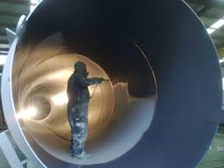
Myth #10
Inspection is a one-size-fits-all solution
Never!
Inspection requirements may be similar for a new project; however, a smart project:
Assesses and documents important differences
Monitors and adjusts plans as needed and
throughout all project phases
Notes:
Even a copy scope project may have substantial differences including changes to best practices, personnel, regulations, specifications, strategies, suppliers, and technologies.

Slide 16
Supplemental Myth #1
Project managers are knowledgeable about inspection
Not necessarily
Inspection myths originate from gaps in:
Engineering educational curriculum
Project management body of knowledge (i.e., PMI. A Guide to the Project Management Body of Knowledge, 7th Edition)
No detailed information or how-to guidelines are provided for inspection
Notes:
For example: engineering identifies the inspection activities, but the inspection budget is prepared by others. If the activities and dollars are not aligned, someone will be disappointed, surprised, or both.

Slide 17
Supplemental Myth #2
Procurement managers and supply chain managers and are knowledgeable about inspection
Not necessarily
Inspection myths originate from gaps in:
Business educational curriculum
Supply chain management body of knowledge (i.e., SCC. The Competencies of Canadian Supply Chain Professionals, 1st Edition)
No detailed information or how-to guidelines are provided for inspection
Notes:
For example: there are many inspection points that each require a 600 km round trip because there is no local inspector. Most of the inspection cost will be for driving. So, shall the inspection proceed, or not?

Slide 18
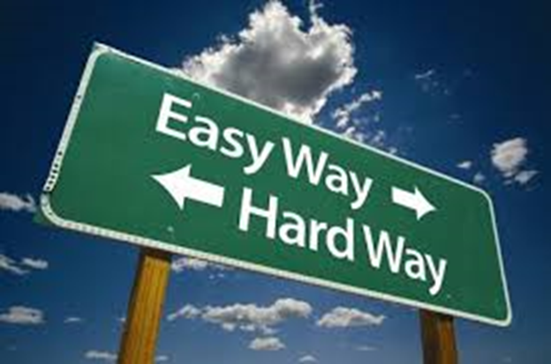
Conclusions
There are knowledge gaps in education and industry because inspection expertise is only available as propriety information and tribal knowledge
With experienced and knowledgeable SQS coordinators and inspectors, and proper planning, a project can mitigate risk to ensure that equipment and materials are delivered:
Complete
Correct
On-time
Notes:
Large projects use proprietary inspection procedures. Tribal knowledge is undocumented, so it is prone to change and varies over time.

Slide 19
Conclusions
Continuous learning is required for career success
More can be accomplished by teamwork than individuals working alone
Projects succeed when collaboration and communication are used effectively and strategically to plan inspection requirements
Knowledge transfer is key to project success, to save:
Money
Time
Notes:
Misunderstanding of inspection is caused by hidden knowledge gaps and not limited to inexperienced personnel.

Slide 20
Learn More
To learn more about project success, see these resources:
Article: Top Ten Myths of Third-party Inspection
eBook: Effective Supplier Quality Surveillance (SQS)
Fact sheet: Top 12 Myths and Facts About Third-party Inspection (document)
Fact sheet: Top 12 Myths and Facts About Third-party Inspection (graphic)

Slide 21
Q&A
Do you have:
Questions to ask?
Comments to discuss?
Notes:
Thank you for your attention. A copy of this presentation is available on request.

Slide 22
Presented by
Roy O. Christensen, RET, CWB Level 3, API 510, ABSA IPV&PPI
hello@ktproject.ca
+1 403.703.2686
www.ktproject.ca

Slide 23
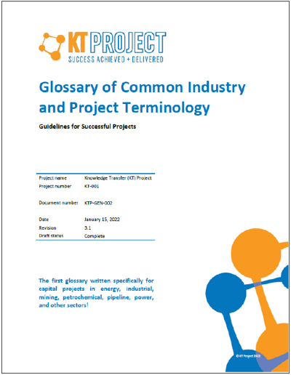
Supplemental Resources
The KT Project glossary (see inset) reduces the risk of miscommunication and misunderstanding in project settings To learn more, see: Successful Projects Need Effective Communication

